Slide 1
Development of master curricula for natural disasters risk management in Western Balkan countries
WP1.2 – Survey of established practices in EU countries for NDRM
Austria
DI Kurt Glock
University of Natural Resources and Life Sciences BOKU, Vienna
Workshop Workshop on master curricula best practices in EU partners
6th April 2017
Project number: 573806-EPP-1-2016-1-RS-EPPKA2-CBHE-JP
"This project has been funded with support from the European Commission. This publication reflects the views only of the author, and the Commission cannot be held responsible for any use which may be made of the information contained therein"

Slide 2
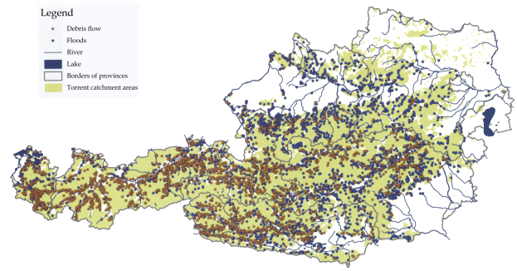
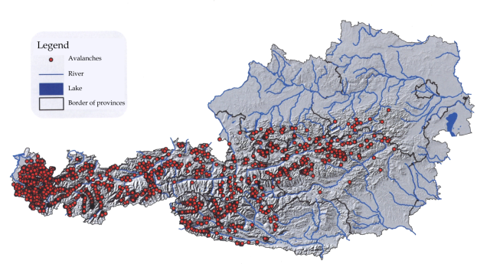
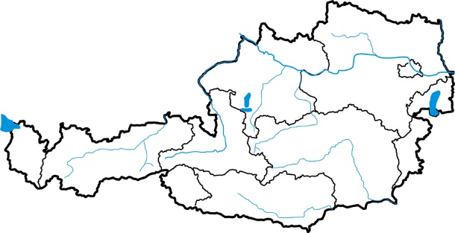
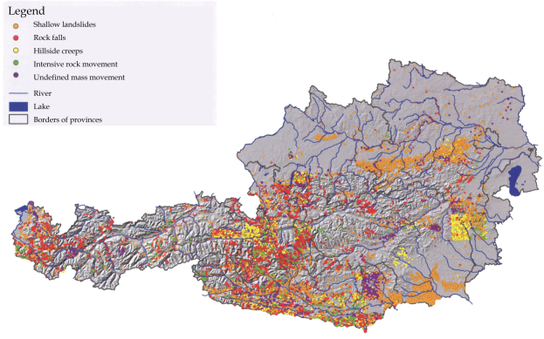
Identification of natural disasters
Development of master curricula for natural disasters risk management in Western Balkan countries
Natural hazards of alpine torrents (debris flows and floods)
Avalanches
Mass movements
(Interpraevent, 2009)
www.stadtplandienst.at
→ 2/3 of the Austrian territory account for alpine regions
Floods in large rivers
(Interpraevent, 2009)
(Interpraevent, 2009)

Slide 3
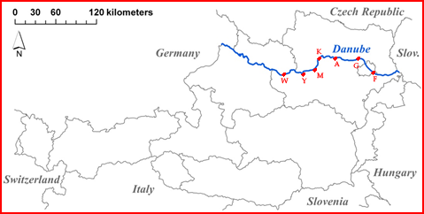
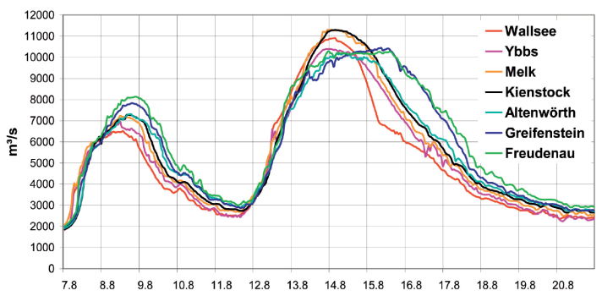
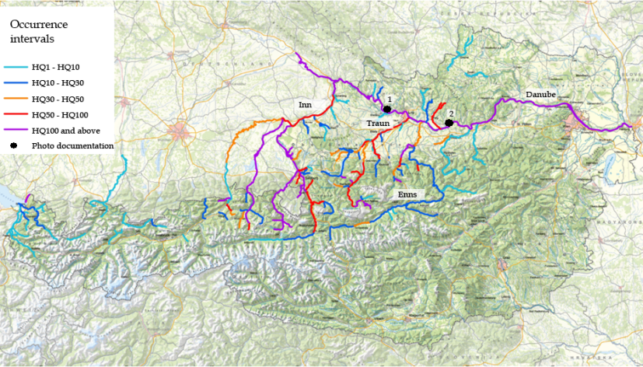
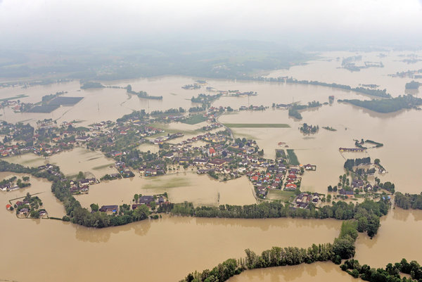
Identification of natural disasters
Development of master curricula for natural disasters risk management in Western Balkan countries
Floods in large rivers
Floods in August 2002
Damage losses of around 3.2 billion Euros
Floods in June 2013
Damage losses of around 866 million Euros
(BMLFUW, 2006)
(BMLFUW, 2015)

Slide 4
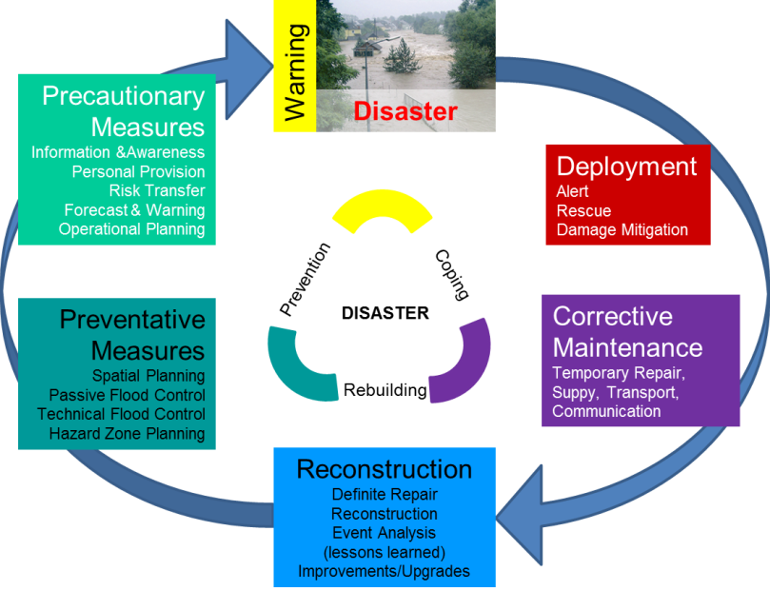
Analysis of established risk management strategies
Development of master curricula for natural disasters risk management in Western Balkan countries
Development of management strategies
Middle Ages: Fatalistic attitude → exposed to hazards “We have to live with them!”
19th century: rational ideologies → technical, systematic strategies
“We can prevent everything!”
Since 1980s: integrated natural hazard management → risk circle with sustainable measures
“We have to cope natural hazards!”
“We have to rebuild, if possible!”
“We have to prevent, if possible!”

Slide 5
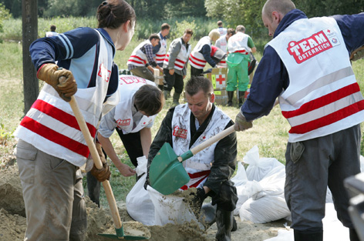
Analysis of established risk management strategies
Development of master curricula for natural disasters risk management in Western Balkan countries
Integrated natural hazard management
Deployment
Immediately after the disaster
Urgent measures / Damage mitigation
Responsible authorities
Police,
Fire brigade
Red Cross
Austrian Armed Forces
Voluntary aid organisation “Team Österreich”
(Around 50.000 volunteers)
(Hitradio Ö3)

Slide 6
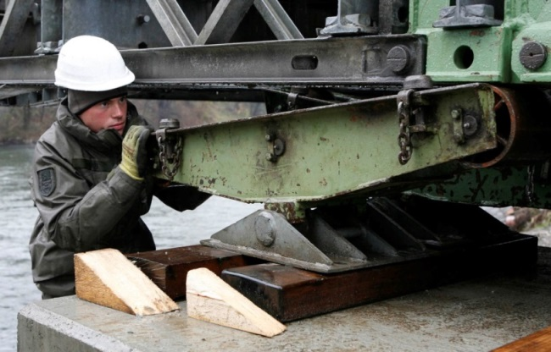
Analysis of established risk management strategies
Development of master curricula for natural disasters risk management in Western Balkan countries
Integrated natural hazard management
Corrective Maintenance
Hours to days after the disaster
Repair of necessary infrastructure
Bridges
Streets
Power and water supply
Telecommunication network
Humanitarian & financial support
Collection of information
Mapping
Photos
Etc.
Responsible authorities similar to Deployment
(Bundesheer – Moser, 2009)

Slide 7
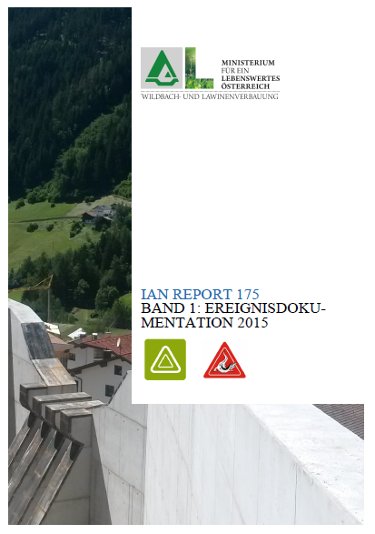
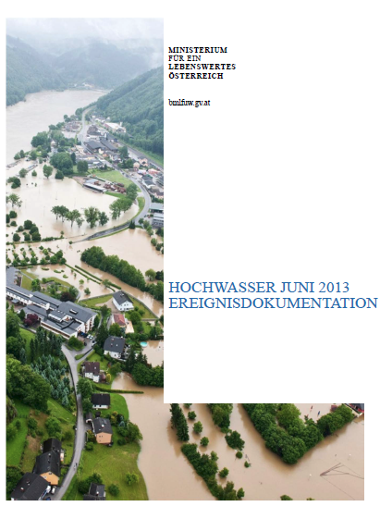
Analysis of established risk management strategies
Development of master curricula for natural disasters risk management in Western Balkan countries
Integrated natural hazard management
Reconstruction
Days to months (years) after the disaster
Definitive reconstruction
Buildings
Streets
Infrastructure
Event analysis – “Lessons learned”
Improvement of strategies and measures

Slide 8
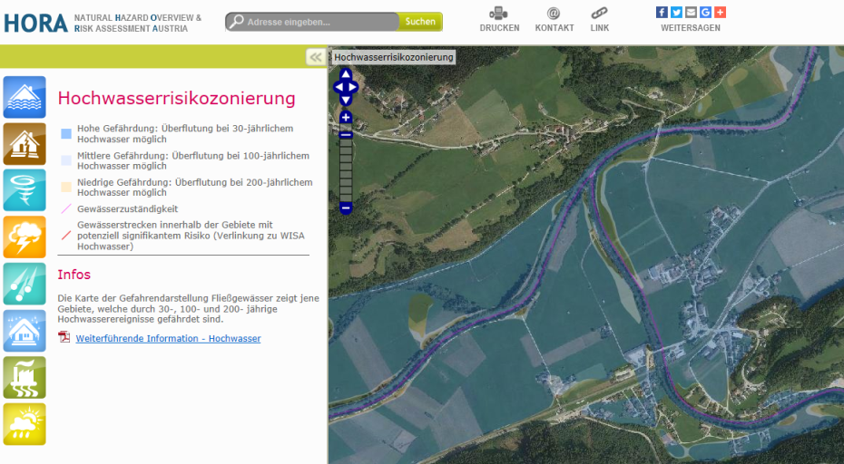
Analysis of established risk management strategies
Development of master curricula for natural disasters risk management in Western Balkan countries
Integrated natural hazard management
Preventive Measures
(Months) and years after the disaster
Reduction of intensity and frequency of natural hazards
Specific laws
Scientific research
Monitoring
Preventive planning
Engineering and ecological measures
Protection of buildings
HORA – Natural Hazard Overview and Risk Assessment Austria

Slide 9
Analysis of established risk management strategies
Development of master curricula for natural disasters risk management in Western Balkan countries
Integrated natural hazard management
Precautionary Measures
Part 1
(Months) and years after the disaster
Public information & awareness
Risk transfer (e.g. insurances)
Personal provision (e.g. incentives)
Part 2
Shortly before the disaster
Weather forecast
Early warning systems

Slide 10
Analysis of responsible institutes
Development of master curricula for natural disasters risk management in Western Balkan countries
Integrated natural hazard management
Balancing act between “central control” and “local action”
Regional presence
Immediate availability
Coordinated action
Natural hazards management
Municipal administration
Federal administration
General public
Insurance companies
Sciences
Provincial administration
NGOs

Slide 11
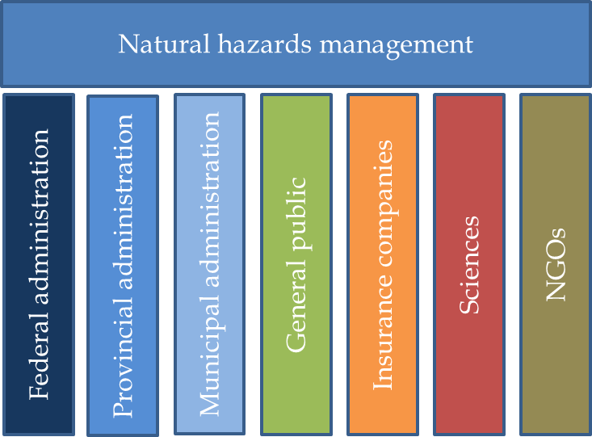
Analysis of responsible institutes
Development of master curricula for natural disasters risk management in Western Balkan countries
Integrated natural hazard management
Public authorities
Federal administration
Prevention measures
Consideration of laws (Water Act, forest law, etc.)
Many different authorities and institutions (Railway agency, Central Institution for Meteorology and Geodynamics, etc.)
Provincial administration
Coping measures embedded in provincial laws
Execution of federal laws
Many different authorities and institutions (Environmental authority, Disaster Control authority, etc.)
Municipal administration
Execution of federal and provincial laws (in the district)
Mayor, Building authority

Slide 12
Analysis of responsible institutes
Development of master curricula for natural disasters risk management in Western Balkan countries
Integrated natural hazard management
General public
Personal provision
Behavioural provision
Self-help in emergency situations
Media
Important multipliers of knowledge and information
Dissemination of calls and announcements is foreseen by law
Insurance companies
Private insurance → Risk transfer
Rarely established → Federal disaster funds
(Exceptions: Storm and hail)
Science and standardisation institutes
Research issues
Education
Development of guidelines and standards
NGOs
Environmental protection
Research
Austrian Alpine Association, WWF, Greenpeace, etc.

Slide 13
Assessment of risk management aspects
Development of master curricula for natural disasters risk management in Western Balkan countries
Advantages
Integrated natural hazard management
Coping, rebuilding and prevention measures
Comprehensive services for all parties
Sustainable treatment of natural disasters → risk circle
Emergency services
Well organized cooperation
A large number of volunteers (fire brigade, red cross, “Team Austria”, etc.)
Trainings and educational courses are provided → Significant decrease of fatalities

Slide 14
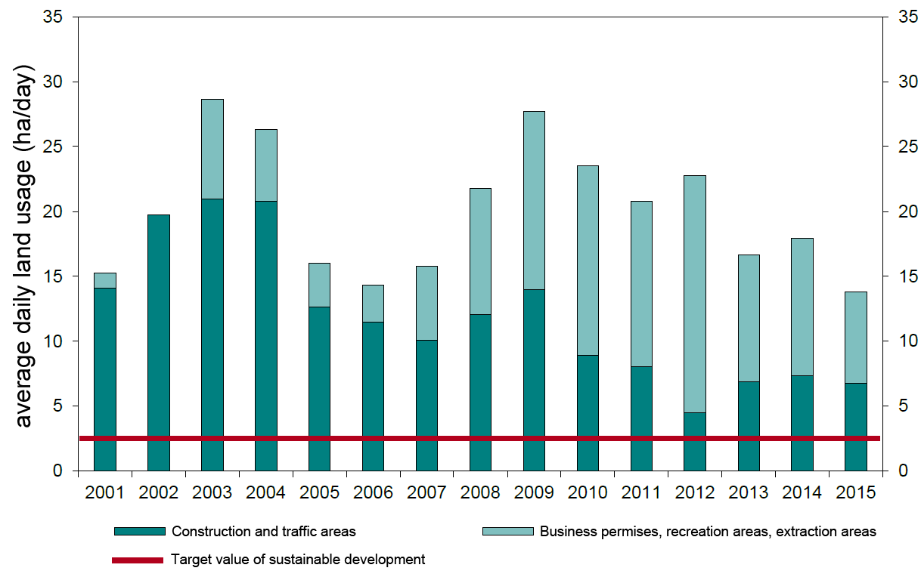
Assessment of risk management aspects
Development of master curricula for natural disasters risk management in Western Balkan countries
Disadvantages
Awareness of land use
Buildings in potential vulnerable areas → unsustainable land use and land sealing
Organizational structure of natural hazards management
A lot of federal, provincial and municipal organizations
Challenging cooperation between these institutes
Examples a) Federal organizations “WLV” (alpine region) and “BWV” (large rivers) b) 9 different provinces with 9 different spatial planning laws

Slide 15
Assessment of risk management aspects
Development of master curricula for natural disasters risk management in Western Balkan countries
Knowledge gaps
Scientific research
Long tradition in data acquisition in Austria (→ solid base for research)
Expansion of gauges (e.g. permafrost, sediment transport, etc.)
Improvement of existing risk management strategies
Public awareness
A lack of understanding of natural hazards in Austrian population
Increase of information and participation events to be better prepared in case of natural disasters

Slide 16
Analysis of EU master curricula
Development of master curricula for natural disasters risk management in Western Balkan countries
In Austria a few master’s degree programmes related to natural disaster risk management are available at different universities.
Master´s programme | Academic degree | University
Alpine Natural Dangers / Watershed Regulation | MSc | University of Natural Resources and Life Sciences, Vienna
Civil Engineering and Water Management | MSc | University of Natural Resources and Life Sciences, Vienna
Geotechnical and Hydraulic Engineering | MSc | Graz University of Technology
Civil Engineering | MSc | Vienna University of Technology

Slide 17
Analysis of EU master curricula
Development of master curricula for natural disasters risk management in Western Balkan countries
Alpine Natural Dangers / Watershed Regulation
University of Natural Resources and Life Sciences Vienna, BOKU
Occupational fields
Evaluation and analysis of hazards and mass movements in alpine regions
Prevention of alpine natural hazards
Integrated river basin management
Risk prevention
Disaster management
Scope and classification (120 ECTS)
Compulsory courses: 22 ECTS
Master thesis: 30 ECTS
Elective courses: 50 ECTS
Free elective courses: 18 ECTS

Slide 18
Analysis of EU master curricula
Development of master curricula for natural disasters risk management in Western Balkan countries
Civil Engineering and Water Management
University of Natural Resources and Life Sciences Vienna, BOKU
Occupational fields
Water management
Land management, construction engineering and management
Traffic and infrastructure management
Waste management
Geoinformation
Risk management
Scope and classification (120 ECTS)
Compulsory courses: 29 ECTS
Master thesis: 30 ECTS
Elective courses: 48 ECTS (incl. subject: Risk Management and Resource Protection)
Free elective courses: 13 ECTS

Slide 19
Analysis of EU master curricula
Development of master curricula for natural disasters risk management in Western Balkan countries
Geotechnical and Hydraulic Engineering
Graz University of Technology, TU Graz
Occupational fields
Geotechnics
Soil mechanics
Foundation engineering
Rock mechanics
Tunnelling
Hydraulics
Hydraulic engineering
Urban water management
Scope and classification (120 ECTS)
Compulsory courses: 27.5 ECTS
Master thesis: 30 ECTS
Elective courses: 50.5 ECTS (incl. subject: Hydraulic Engineering)
Elective courses (soft skills): 6 ECTS
Free elective courses: 6 ECTS

Slide 20
Analysis of EU master curricula
Development of master curricula for natural disasters risk management in Western Balkan countries
Civil Engineering
Vienna University of Technology, TU Wien
Occupational fields
Structural engineering
Geotechnics
Construction management
Traffic and mobility
Water & resources
Scope and classification (120 ECTS)
Compulsory courses: 52 ECTS (incl. subject: Geotechnics)
Master thesis: 30 ECTS
Elective courses: 21 ECTS
Project: 8 ECTS
Free elective courses (+soft skills): 9 ECTS

Slide 21
Contact information
Development of master curricula for natural disasters risk management in Western Balkan countries
University of Natural Resources and Life Sciences Vienna (BOKU)
Department of Water, Atmosphere and Environment (WAU)
Institute of Water Management, Hydrology and Hydraulic Engineering (IWHW)
Kurt Glock
Dipl.-Ing.
E-mail: kurt.glock@boku.ac.at
Michael Tritthart
Priv.-Doz. Dipl.-Ing. Dr.techn.
E-mail: michael.tritthart@boku.ac.at

